Slide 1
SE305 Database System Technology
Quiz-2

Slide 2
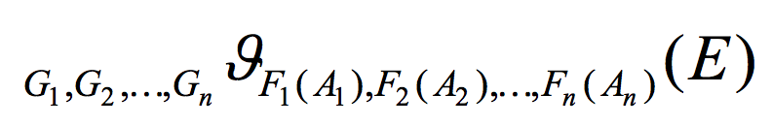
1. Aggregate operation in relational algebra
E is any relational-algebra expression, which statement is False?
a)G₁, G₂ ..., G_{n} is a list of attributes on which to group (can be empty)
b) Each F_{i} is an aggregate function
c) Each A_{i} is an attribute name
d) A₁, ..., A_{n} are joint with G₁, ..., G_{n}

Slide 3
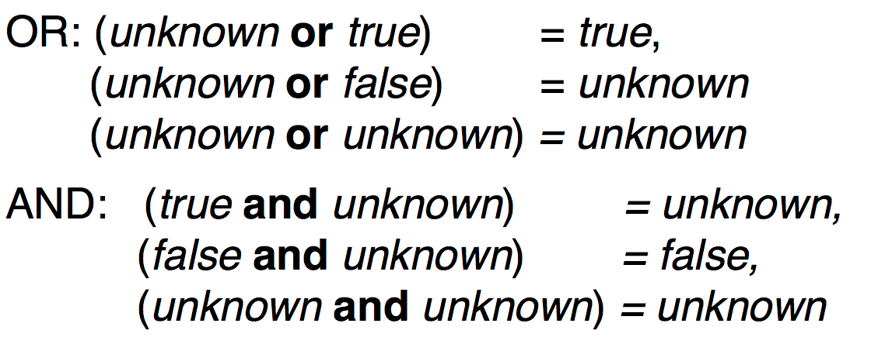

2. In three-valued logic which statement is False? 10’
a)
b)
c)
d) In SQL “P is unknown” evaluates to true if predicate P evaluates to True

Slide 4
3. If we just want to delete all tuples in a table, which SQL query shall we choose? 10’
a) delete * from t;
b) delete from t;
c) drop table t;
d) drop * table t;
4. Consider the query select sum (salary) from instructor, which statement is NOT correct? 10’
a) This query totals all salaries
b) Ignores null values amounts
c) Result is 0 if there is no non-null amount
d) The column name for the sum is sum(salary)

Slide 5
5.Which statement is NOT correct? 10’
a) SQL allows duplicates in relations as well as in query results
b) The From clause corresponds to the cartesian product operation
c) ‘Intro%’ matches ‘Introduction’
d) 5+null returns 5
6. Consider schema R(a,b,c), which query is correct? 10’
a) SELECT a FROM R GROUP BY b,c
b) SELECT a,b FROM R GROUP BY c
c) SELECT avg(a),min(b) FROM R GROUP BY c
d) SELECT a,b FROM R GROUP BY b

Slide 6
7. With SQL, how do you select a column named "FirstName" from a table named "Persons"? 10’
a)extract FirstName from Persons
b)select Persons.FirstName
c)select FirstName FROM Persons
d)extract Persons.FirstName
8. With SQL, how do you select all the columns from a table named "Persons"? 10’
a)SELECT * FROM Persons
b)SELECT Persons
c)SELECT [all] FROM Persons
d)SELECT *.Persons

Slide 7
9. Which information is NOT useful in create a schema to represent aggregation? 10’
a) primary key of the aggregated relationship
b) the primary key of the associated entity set
c) any descriptive attributes
d) attributes of the aggregated relationship
10. What does SQL stand for? 10’
a)Structured Question Language
b)Strong Question Language
c)Structured Query Language
d)Strong Query Language

